Slide 1
Putting it all together and testing with HTTPie
Notes:
[Mandatory Slide] This would be the introduction slide of the topic that you are covering in this subsection.
When this slide plays, you could talk about the main aim that we’d be covering in this video.

Slide 2
In this Video, we are going to take a look at…
What is HTTPie?
Code sample: testing
Notes:
[Mandatory Slide]
Before the start of the video, we’d like to highlight what are important topics or pointers that we’d be covering in this video. This slide would immediately follow the intro/name slide. This would just be say 2-3 points for the viewers to know what they are getting into.

Slide 3
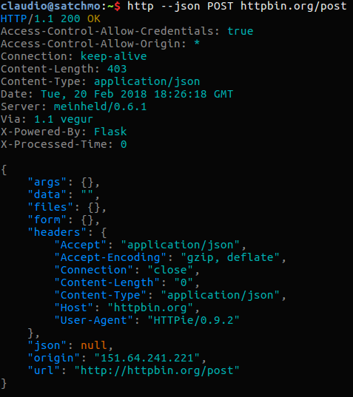
What is Httpie?
HTTPie is a command-line HTTP client. It features a nice (and colorful) interface, which makes it a good alternative to canonical HTTP clients such as cURL
Install it with: pip install httpie
We can use HTTPie to write scriptable integration tests for our API
This can also be done in Python using for example the requests library
Notes:
[Mandatory Slide]
Before the start of the video, we’d like to highlight what are important topics or pointers that we’d be covering in this video. This slide would immediately follow the intro/name slide. This would just be say 2-3 points for the viewers to know what they are getting into.

Slide 4
Code Sample: testing
Notes:
Something that needs to grab the viewers attention!!

Slide 5
Summary
What is HTTPie?
Code sample: testing
Notes:
[Mandatory Slide]
Before the start of the video, we’d like to highlight what are important topics or pointers that we’d be covering in this video. This slide would immediately follow the intro/name slide. This would just be say 2-3 points for the viewers to know what they are getting into.

Slide 6
A Facebook Messenger bot
based on Flask and Heroku
Next Section
Notes:
[Mandatory Slide]
Here the name of the next section needs to be mentioned. The narration as you guessed it would be just letting the viewer know what we’d be taking over next! ☺

